Slide 1
Welcome to Year 2

Slide 2
Good Afternoon
Hello, my name is Mrs Nessa and I am the teacher in Year 2. I have had the pleasure to know the children for a few weeks now and they have had such good learning attitudes.

Slide 3
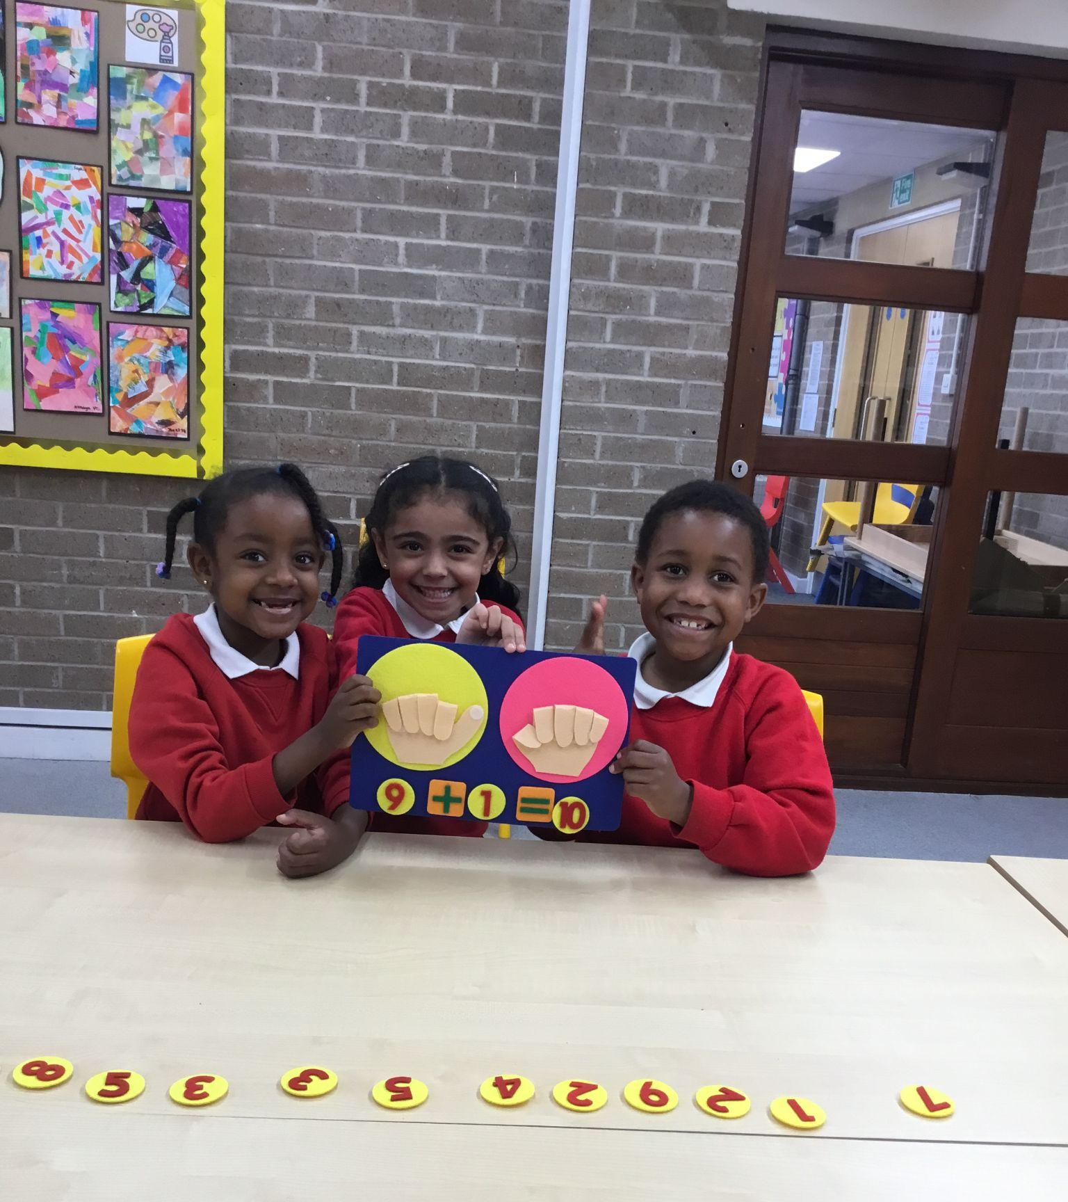
In year 2 this year
Year 2 is a lot different from Year 1. The children will have a lot more work that they will be doing and are pushed even more to achieve their goals.

Slide 4
This Year
We will be learning about…

Slide 5
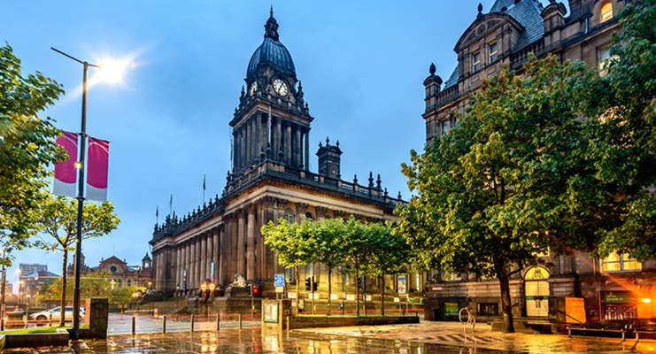
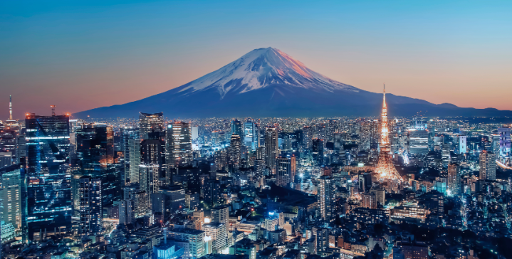
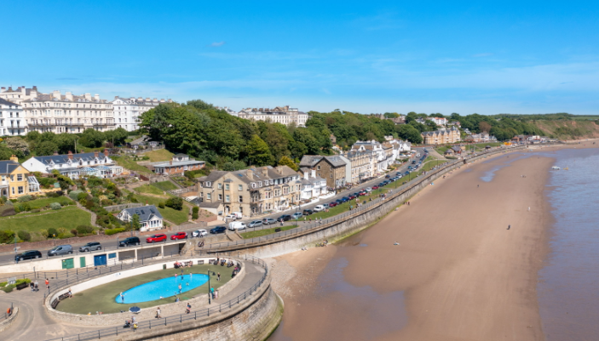
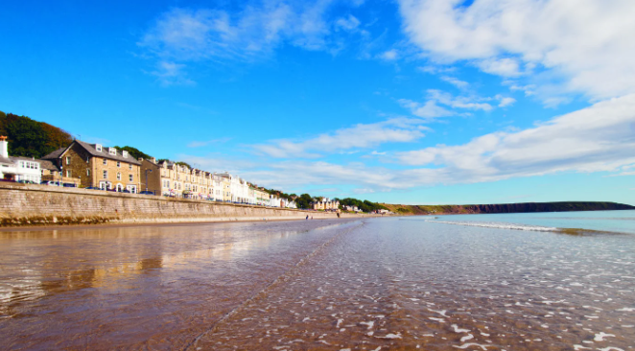
Geography - Leeds and Tokyo / SEaSide

Slide 6
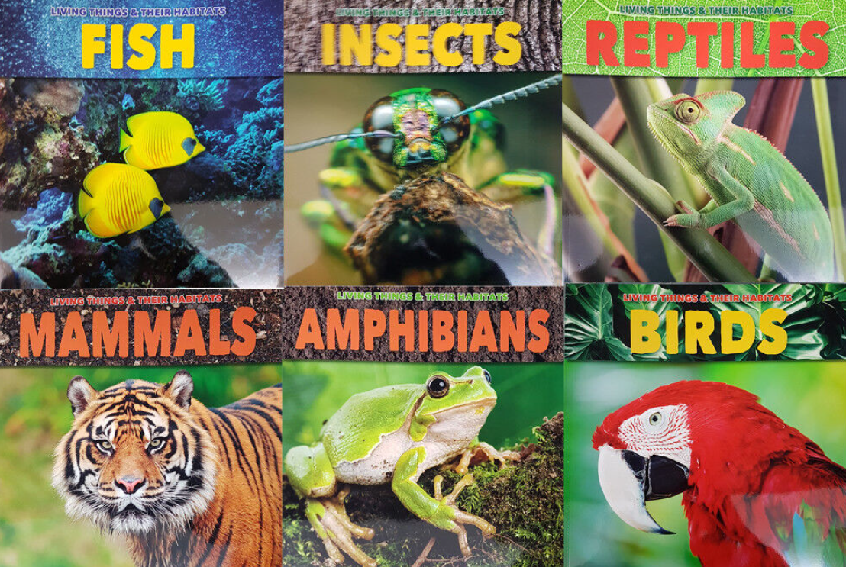
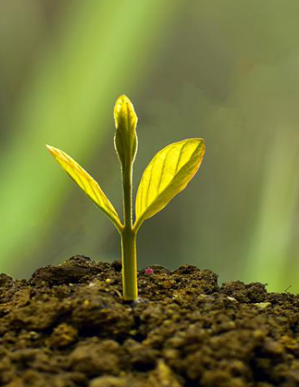
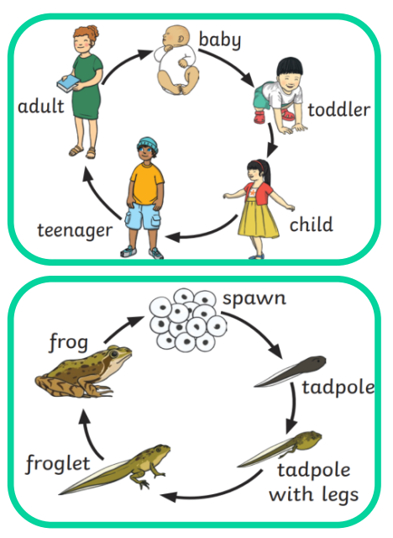
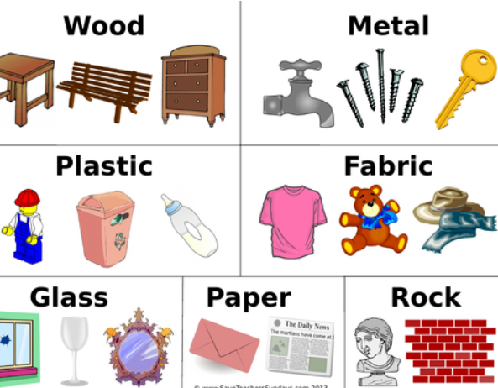
Science - Living things and their habitats/ plants/ Animals including Humans/ Materials

Slide 7
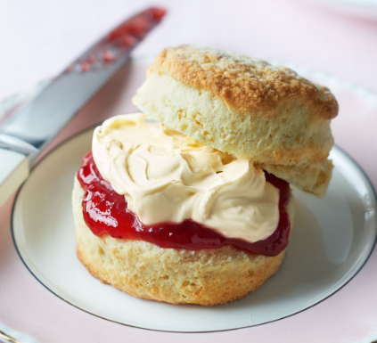
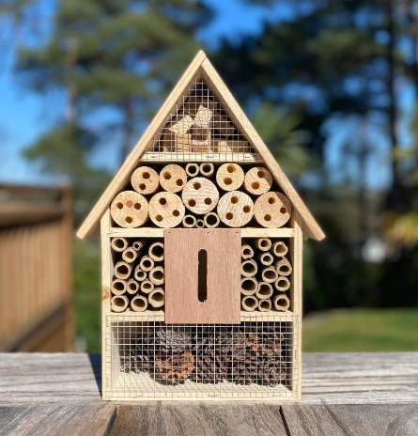
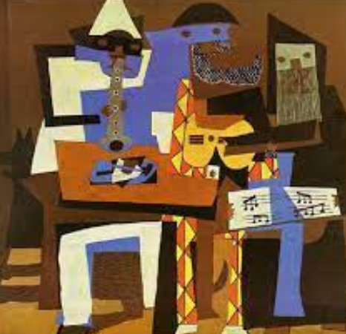
Art and Design Technology

Slide 8
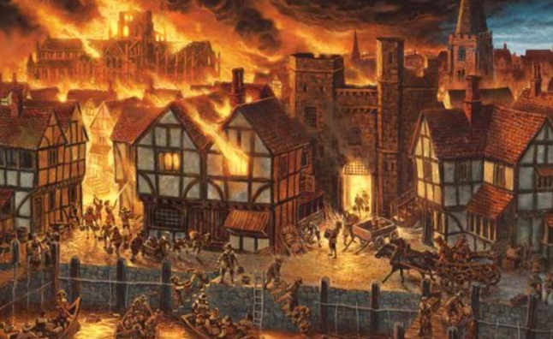
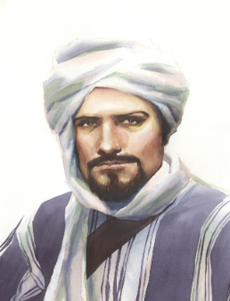
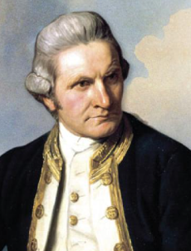
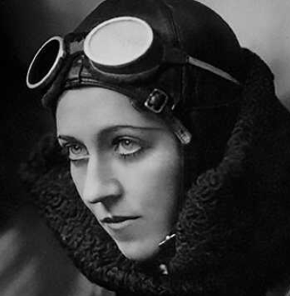
History - Great fire of london / Explorers

Slide 9
The children will be learning a range of different text types in writing and will be doing a lot of reading. So please support them as much as you can at home with their reading and writing.
In Maths we will be learning addition and subtraction, multiplication and division, statistics, money, shape and measurement.
Maths / Reading / Writing

Slide 10
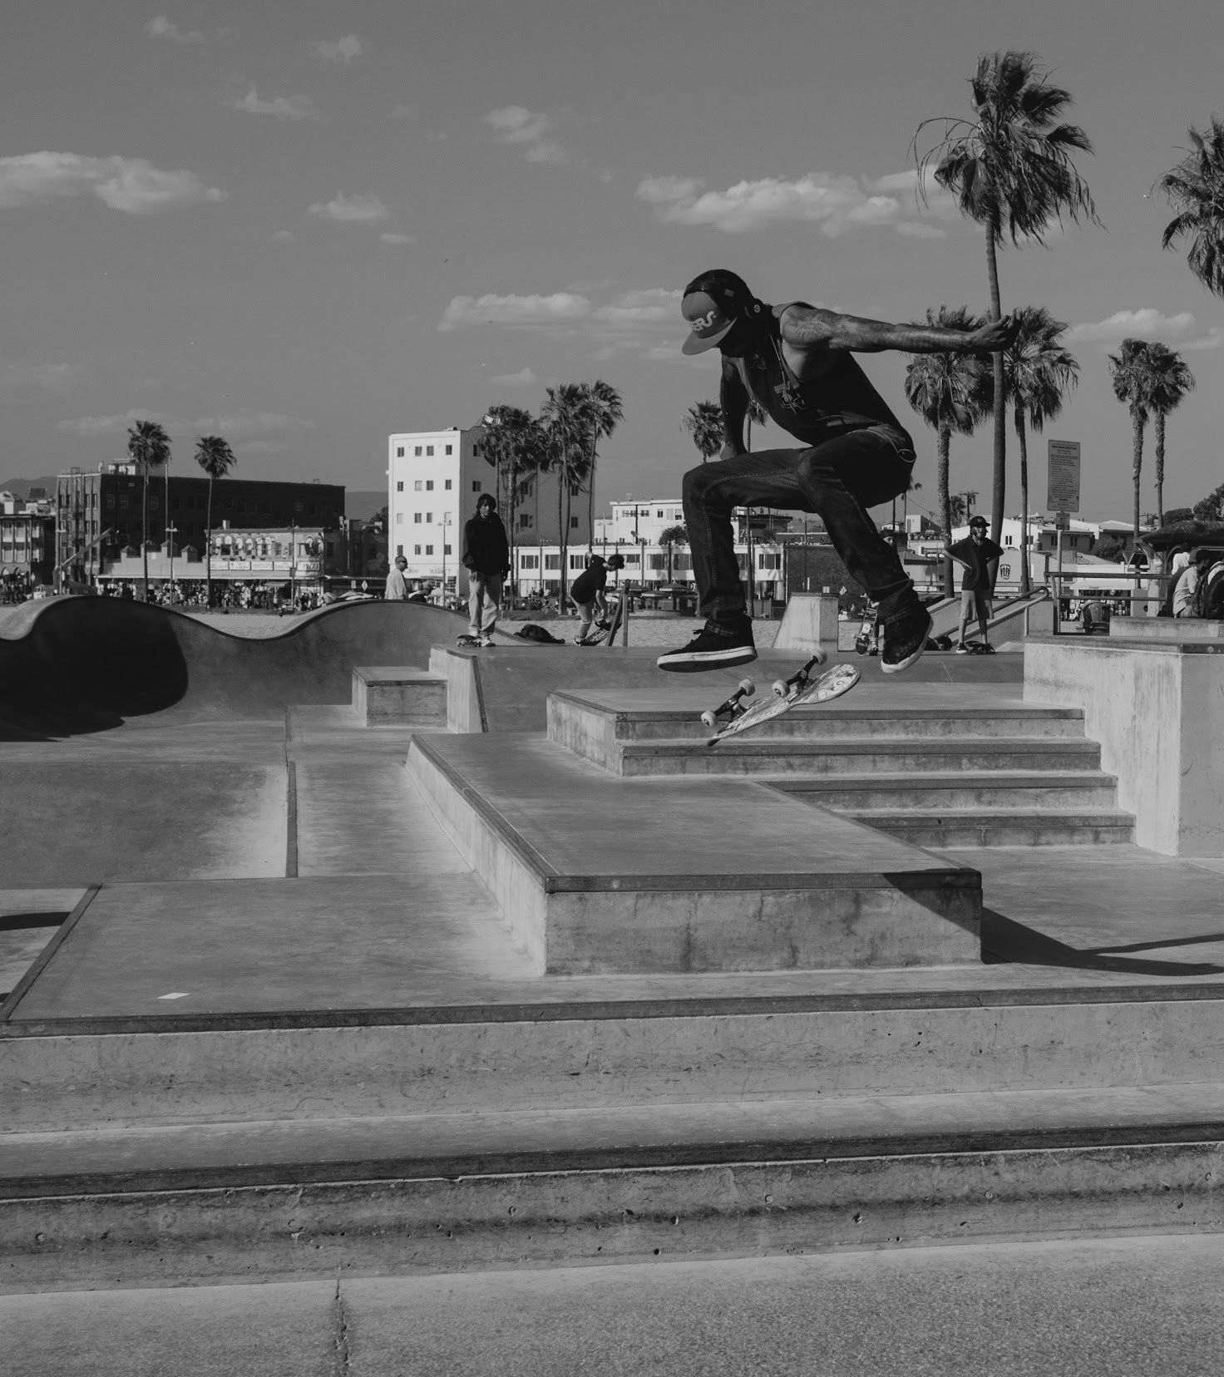
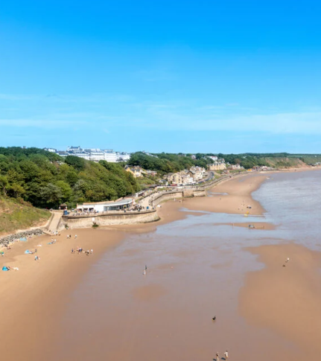
Trips
Year 2 will be visiting Filey Beach in Summer term as part of their geography subject.
We will also be going on a bus tour of Leeds city as part of our Autumn term geography unit.

Slide 11
Assessments
Children in year 2 will have assessments every term to monitor their learning. It is a very important year for them so the children need to be in school everyday as the pace of year 2 is very quick.

